Slide 1
Gold Hill Speed Study
Town Meeting Presentation
April 11, 2022

Slide 2
Currently, No New Traffic Calming Projects are approved to move forward while the County reviews its Speed Management policies and procedures.
The Speed Study was done at the request of Community Members interested in traffic calming and does not guarantee a project will be pursued in the future.
Any Project Moving Forward will be Required to Follow the approval process outlined in the forthcoming Speed Management Plan which will include final plan development, public meeting, and community vote.

Slide 3
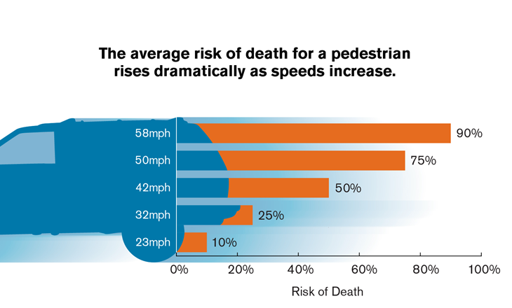
Speed, Safety, and Speed Limits
Generally:
More Speed = More Severe Crashes (Physics)
More Speed = More Crashes
(Not a one-to-one relationship)
While Speed Limits factor into Driver speed selection, it is not the only influence.
Drivers primarily select speed based on perceptual cues and the road environment
The perception of a “safe speed” varies by individual perspective
Lowering the speed limit alone without design changes or constant enforcement will not result in lower speeds.

Slide 4
Speed Management
Identify Speeding Issues
Identify Countermeasures
Implement Countermeasures
Evaluate Projects and Programs

Slide 5
Speed on Main Street
County uses 85th Percentile Speed as a measure of Prevailing Speed
Speed Measurements were last taken in July/August 2021
Measurements were taken in two locations on Main Street with automated radar traffic counters.
Boulder to Hill Street:
85th Percentile: 22 MPH
Median Speed: 17 MPH
Percent Exceeding: 63%
Average Exceeding: 19.8 MPH
Prospect to College Street
85th Percentile: 16 MPH
Median Speed: 14 MPH
Percent Exceeding: 23%
Average Exceeding: 17.7 MPH

Slide 6
Crash History
5 Year History is the typical Analysis Period
From July 2014 to June 2019 there was one recorded crash on Main Street
Was reported as a side-swipe crash (vehicle leaving parked position collided with a vehicle coming the opposite direction)
No known additional crashes since report was released
No Injury Crashes in report history
No Crashes involving bikes or pedestrians
Crash did not appear to be speeding related

Slide 7
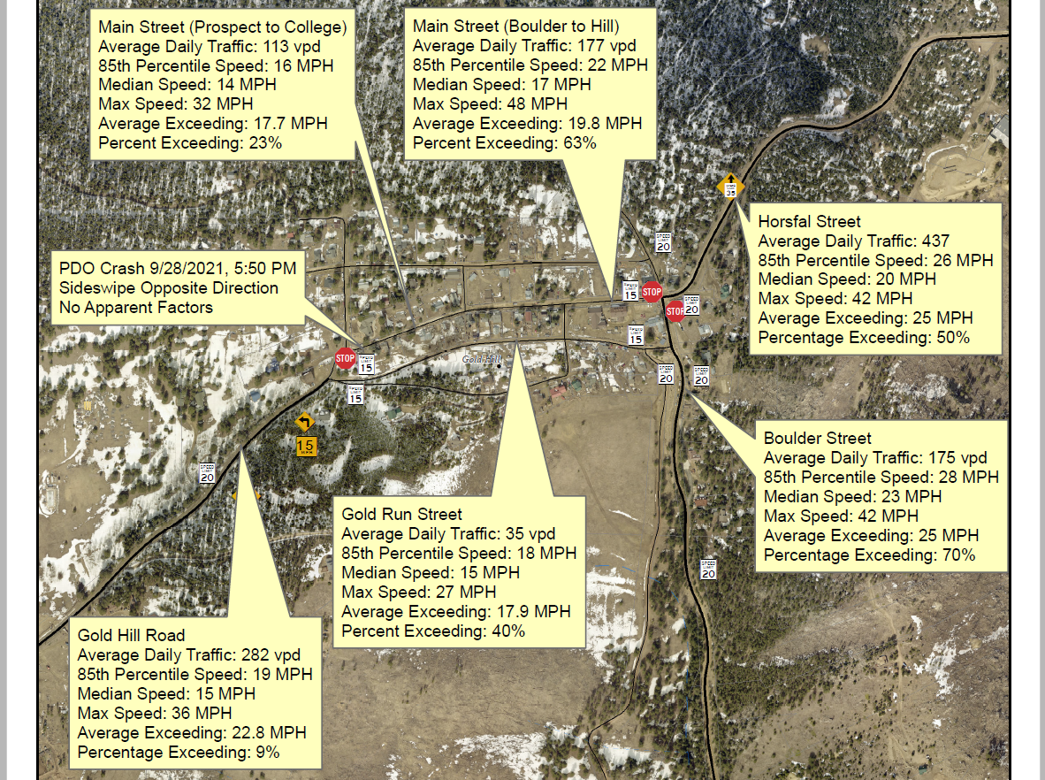

Slide 8
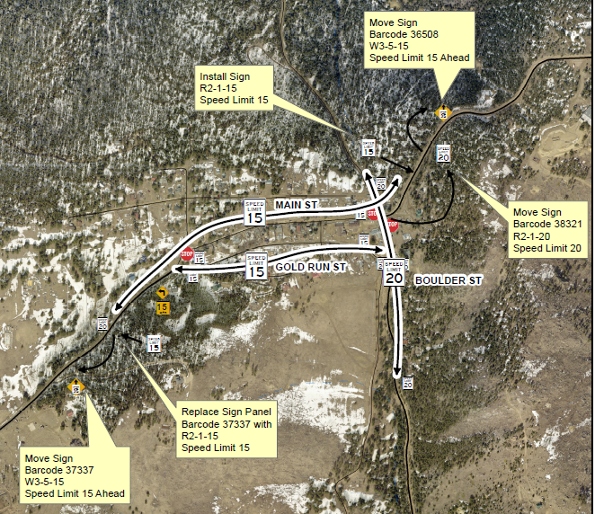
Speed Limit Review
Highest 85th Percentile Speeds were 7 MPH and 8 MPH over the Limit (Main and Boulder Streets Respectively)
Speed Limits will stay the same
Signs will be moved or added to reduce the speed limit before entering town

Slide 9
Traffic Calming
The primary purpose of traffic calming is to support the livability and vitality of residential and commercial areas often through improvements in non-motorist safety, mobility, and comfort. The objectives are typically achieved by reducing vehicle speeds or volumes using self-enforcing physical or psycho-perception techniques to produce the desired effects.
Traffic calming techniques attempt to reduce the number of drivers who exceed the limit and discourage excessive speeds by those who still exceed the limit.

Slide 10
Eligibility & Priority (Main Street)
Eligibility determines what, if any, traffic calming measures will be allowed. Based on…
Speed (15 MPH Speed Limit; 85th Percentile 7-8 MPH over the limit),
Volume (<1000 vehicles per day),
Functional Classification (“Local” as shown on the County Road Map),
Emergency/Transit Use (Has Both).
Priority will determine which projects will be addressed first. Based on…
85th Percentile Speed (7-8 MPH over the limit),
Traffic Volume (<1000 vehicles per day),
Crash Experience (1 Non-Speeding PDO Crash),
Presence of Bicycle and Pedestrian Facilities & Generators (No Facilities, School and Businesses generating pedestrian traffic)

Slide 11
Neighborhood Project Process
Citizen Request
Project Planning
Conceptual Plan Review
Final Plans
Project Implementation
Speed Study
Determine Eligibility and Priority for Traffic Calming
Requestors meet with County Staff
Staff Draft Conceptual Plan
Requestors must gather feedback/hold meeting
County Staff Draft Final Plans & Cost Estimate
Requestor and County Distribute Plans and host public meeting
Community Votes to approve project
Project Funding
Post Implementation Evaluation
Construction

Slide 12
Thank You
Joshua Trickey
Traffic Operations Engineer
Boulder County Public Works
TDAdmin@bouldercounty.org
303-441-3900
www.bouldercounty.org

