Slide 1
2023 WILDFIRE PLANNING AND IMPLEMENTATION OVERVIEW
February 13, 2023

Slide 2
Agenda
Start with large scale info and move into local planning:
Federal funding and wildfire planning
State funding and wildfire planning
County funding and wildfire planning
Gold Hill work
Ashram/Ashley project
Forest restoration phase 2
West Gold Hill
Structure protection
Slash Pile Burning 101 field day

Slide 3
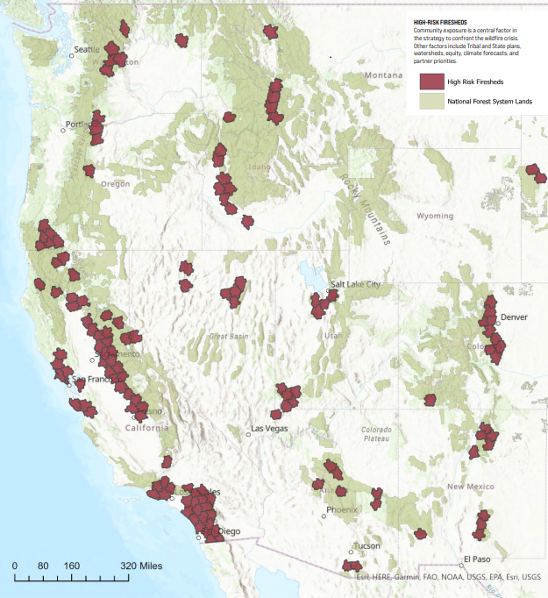
Federal Funding and Wildfire Planning
Infrastructure Law Funding identified priority Firesheds
Front Range USFS awarded 18 Million in 2022 and 37.5 Million in 2023.
Funding used to hire staff, fuels reduction projects and pile burning.
Arapaho Roosevelt Forest is developing a fund with the National Forest Foundation for use on private lands.

Slide 4
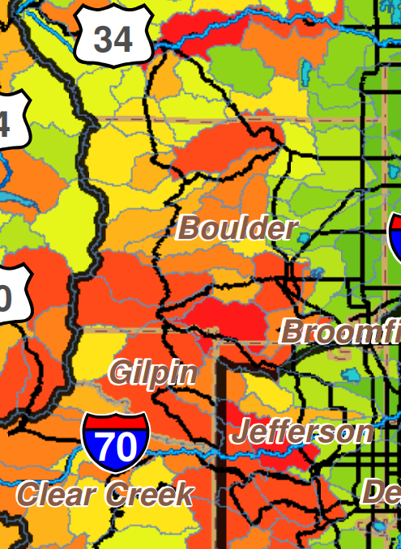
State Funding and Wildfire Planning
Colorado State Forest Service grant funds:
In previous years 1 million dollars available, in 2022 15 million dollars available (2 million awarded in Boulder County)
Colorado Strategic Wildfire Action Program:
New program through DNR for 10 priority landscapes (including Boulder County).
Wildfire Ready Watersheds:
Funding and technical assistance to help communities pre-plan for post wildfire impacts.

Slide 5
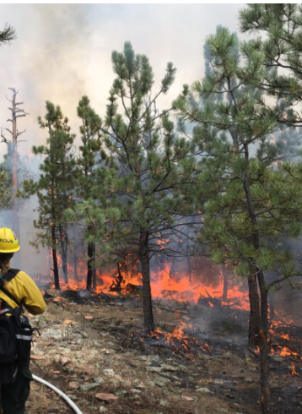
Boulder County and Wildfire Planning
Mitigation Tax (1A) passed in 2022:
Estimated to bring ~9 million dollars annually for wildfire mitigation.
Includes Wildfire Partners expansion into east Boulder County.
A grant program will be developed for forest and grassland fuels reduction.
Boulder County Fireshed:
Numerous local, state and federal partners conducting local planning.
CWPP development: local planning.
St Vrain Forest Health Partnership/ Boulder Watershed Collective:
Facilitating collaborative planning, acquiring grant funds and implementing wildfire resilience projects.

Slide 6
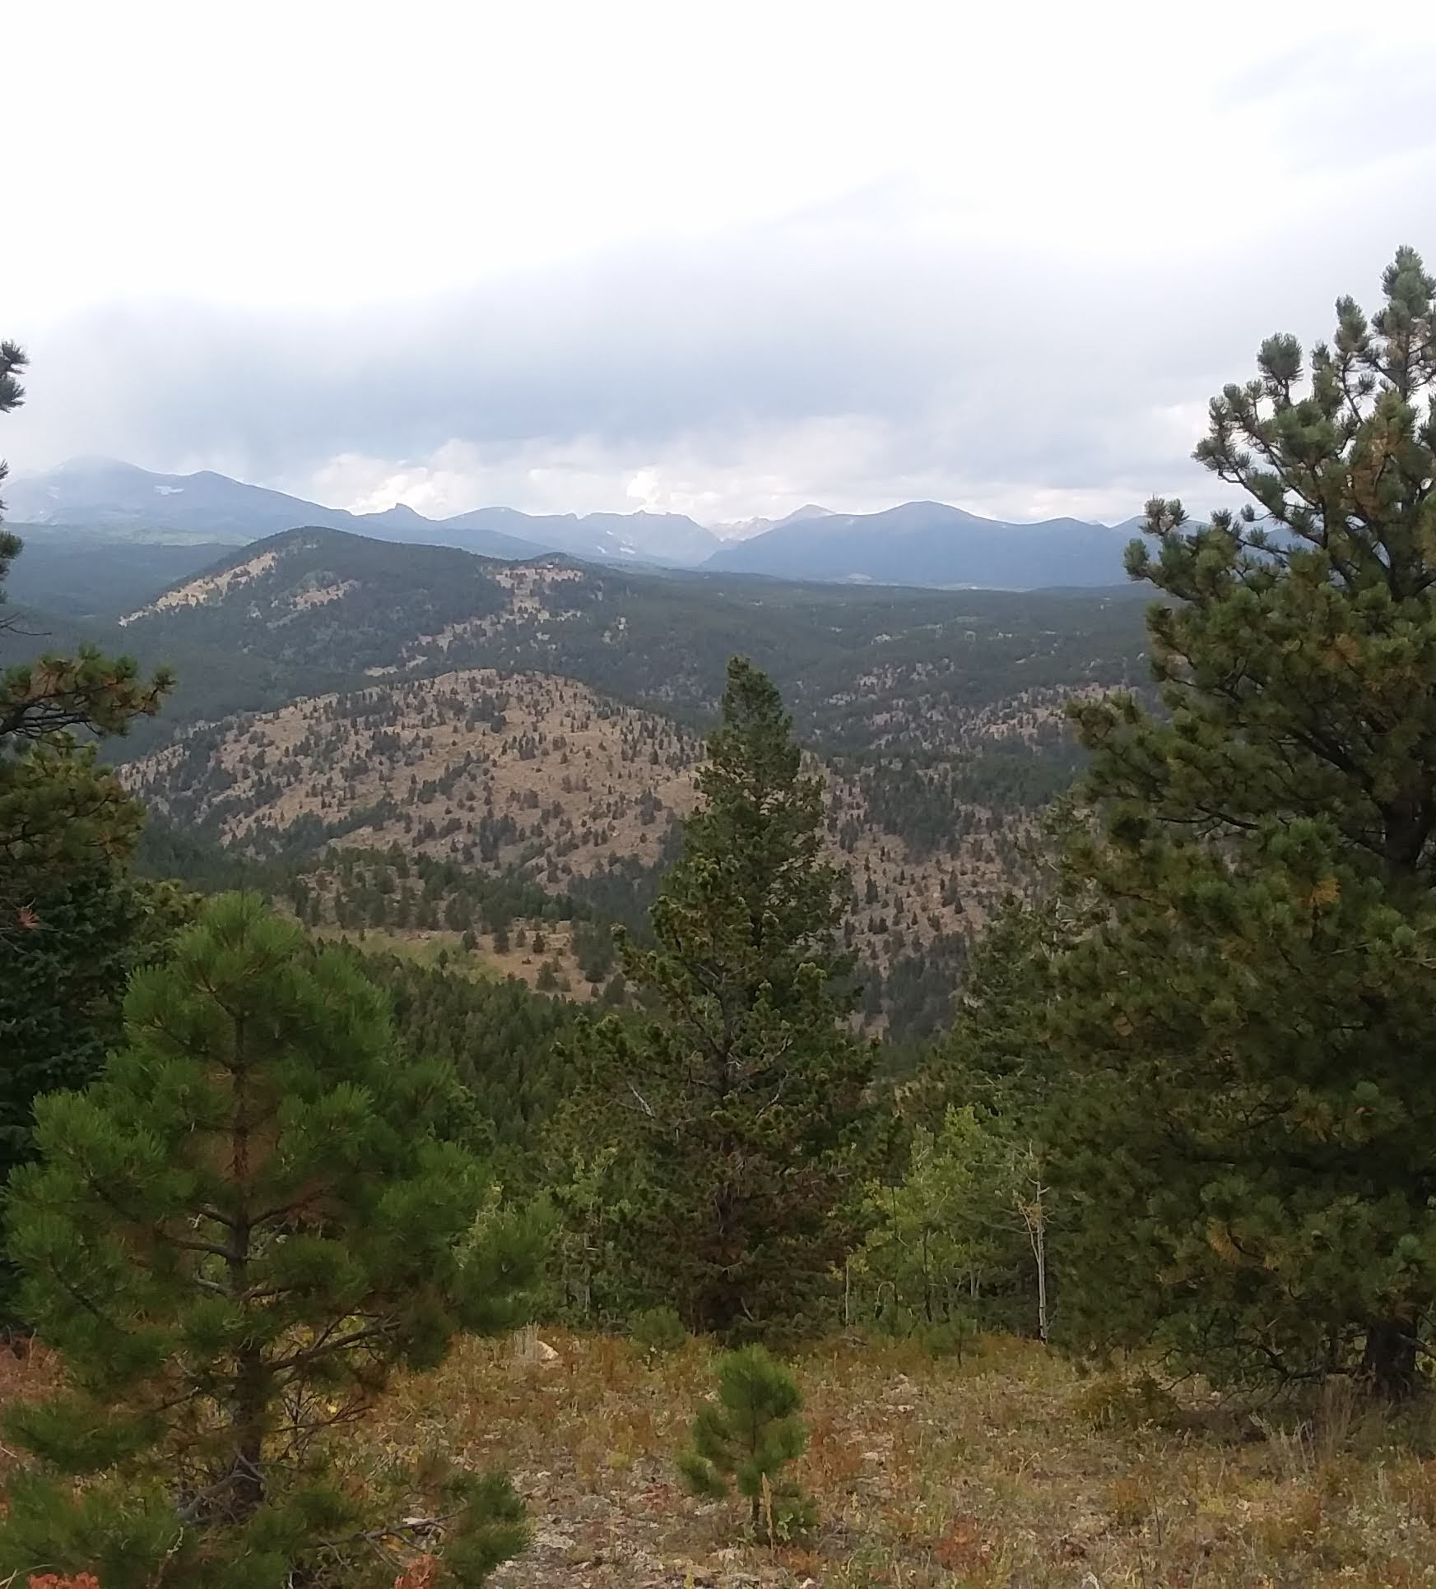
Gold Hill and Wildfire Planning
Ashram & Ashley Forestry Project: 104 acres
In process
Gold Hill Phase Two: 45 acres
In planning
West Gold Hill: 145 acres
In planning with Boulder Valley and Longmont Conservation District and Colorado State Forest Service
Other Wildfire Planning
Structure protection, Education, Grazing

Slide 7
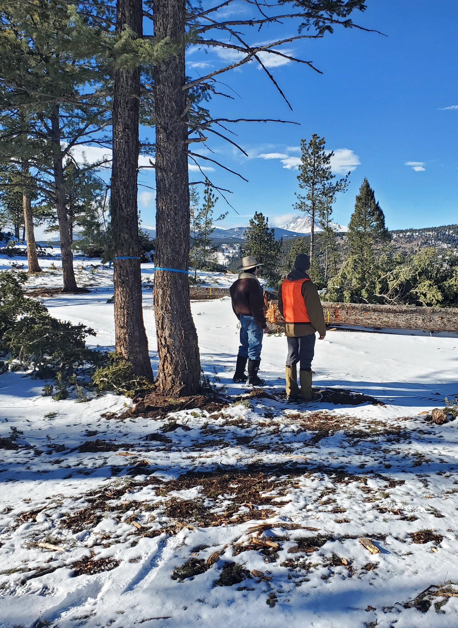
Ashram/Ashley project
Goals:
Firebreak adjacent to Town
Increase protection of firefighters and ability to defend homes.
Decrease high severity fire immediately adjacent to town.
Forest Health
Create heterogeneity on the landscape (a mosaic of dense and open forest).
Increase/enhance Aspen and their ability to proliferate.
Increase diversity through access to sunlight and less competition for resources.

Slide 8
You Are Invited! Ashley Project Site Visit
This Thursday at 4pm.
Take a short walk around the treatment area.
Talk with the Boulder County Conservation District Forester and Contractor.
Meet at the big log pile behind the Finn’s house.
_______________________________________________
Slash Pile Burning 101 with USFS the week of Feb 20th.

Slide 9
www.boulderwatershedcollective.org

